Slide 1

UPDATE
Kentucky Transportation Cabinet
December, 2018

Slide 2


Strategic
Highway
Investment
Formula for
Tomorrow
Notes:
In 2016 and for several years before that our Highway Plan had many more projects than dollars to pay for them.
Only 10 percent of the $7.1 Billion of state projects promised had state funds to pay for them in the 16 plan.
In short, we were over programming and overpromising.
As a result, Gov. Matt Bevin directed KYTC to develop a more data-driven, objective approach to prioritizing projects.
Our response to the Governor’s challenge was SHIFT: the Strategic Highway Investment Formula for Tomorrow.
It was developed over a couple years and used to craft the draft recommended 2018 highway plan.
We are now working to improve the tool for development of the 2020 highway plan.

Slide 3
SHIFT is…
Data driven and objective
A comparative guide
Incorporates local input
Similar to successful approaches of other states
Transparent and defensible
Notes:
A data-driven, objective approach to prioritizing projects.
A comparative guide that helps decision makers.
An application of hard data with allowance for input and minor adjustment at the local level.
Similar to successful approaches that other states have implemented.
Transparent and defensible.

Slide 4
SHIFT Results – 2018 Highway Plan
495 Safety and Mobility Projects 85 Relate to Ferry Operations and Various Funding 303 Originate from SHIFT
State Funds Less Over-programmed Biennium Total Plan
Silver Lining Flexibility Improvement over previous Plans
2016
$3 B
2018
$200 M
2016
$7 B
2018
$1.8 B
Notes:
SHIFT 2018 was a success.
We sent over a balanced recommended highway plan and the Enacted Plan has minimal over programming compared to previous year.
74% of the Safety and Mobility Projects in the highway plan originated from SHIFT.
We have the ability to keep the promises that have been made in this highway plan. And, we are working hard to do that.
And, we are working hard to make sure we build on this success and momentum….we are working to improve SHIFT for development of the 2020 highway plan.

Slide 5
Focus on Safety and Improvements
PROJECTS INCLUDED
Safety Improvements
Road Widening
Reconstruction
New Routes and Interchanges
PROJECTS OUTSIDE
Rural and Municipal Aid
Maintenance Work
Federally Dedicated Projects (CMAQ, TAP, HSIP,…)
MPO Dedicated Projects
Notes:
About half of what we produce here at KYTC goes through shift.
This includes major capitol improvement projects, like those shown here.
These other types of projects do not go through SHIFT. They each have their own selection processes unique to the goals of each
SHIFT is used to score major capital improvement projects…widening proejcts, reconstruction, new routes and interchanges.
SHIFT does not score projects funded with the state dollars dedicated to our counties, or federally dedicated dollars for our mpos or for the cmaq te/tap or hsip programs or routine maintenance projects.
These other areas and program have selection processes unique to their program goals.

Slide 6
SHIFT Process
Sponsorship of projects for scoring
Data Verification
Statewide Scoring: Establish statewide priorities
Regional Scoring: Local Boost / Regional funding Priorities
Draft Recommended Highway Plan
Notes:
Sponsorship of projects for scoring
Data verification
Statewide scoring / Establish statewide priorities
Regional scoring / Local boost / Regional funding priorities
Draft recommended highway plan

Slide 7
2020 Sponsorship Allotments
District | # to Sponsor |  | ADD | # to Sponsor |  | MPO | # to Sponsor
1 | 50 |  | BARREN RIVER | 40 |  | Bowling Green | 10
2 | 56 |  | BIG SANDY | 23 |  | Evansville | 6
3 | 48 |  | BLUEGRASS | 67 |  | Louisville | 54
4 | 52 |  | BUFFALO TRACE | 16 |  | KYOVA | 10
5 | 74 |  | CUMBERLAND VALLEY | 38 |  | Lexington | 23
6 | 53 |  | FIVCO | 16 |  | OKI | 27
7 | 68 |  | GATEWAY | 18 |  | Owensboro | 9
8 | 45 |  | GREEN RIVER | 23 |  | Radcliff | 12
9 | 40 |  | KENTUCKY RIVER | 29 |  | Clarksville | 3
10 | 35 |  | KIPDA | 22
11 | 37 |  | LAKE CUMBERLAND | 43
12 | 31 |  | LINCOLN TRAIL | 30
 |  |  | NORTHERN KENTUCKY | 23
 |  |  | PENNYRILE | 41
 |  |  | PURCHASE | 36
Notes:
A project must be sponsored to be scored…..
Area Development Districts, Metropolitan Planning Organizations, and KYTC Highway District Offices can sponsor projects for scoring.
The number of sponsorships for each of those groups is determined by the number of counties, population, and lane miles within the jurisdiction of these agencies.
This approach allows for about 1200 projects to be sponsored.
For SHIFT 2018 the total allowance was 1191
For SHIFT 2020 the total allowance is 1208
Sponsorship # = 2*Number of Counties + Population/25000 + Lane Miles/1000
Updated to 2017 Census numbers and recalculated numbers for all entities
Data Management provided Public Road Lane miles for all entities

Slide 8
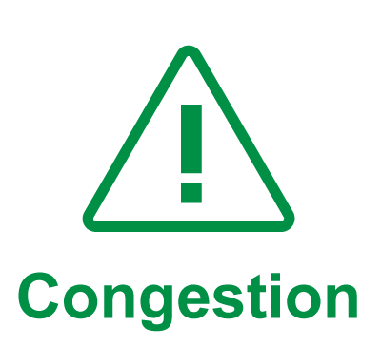




Formula Components
Notes:
The SHIFT formula scores each project on these elements.

Slide 9
Two Phase Prioritization
Statewide Mobility
(Central Office)
District Impact
(ADD,MPO,HDO)
Focus → Address Congestion and Bottlenecks
Eligible Projects
Statewide type Projects (Interstates/NHS)
Selection100% Data
Projects Programmed prior to Area Planning Input
Focus →
Improve Connectivity within Districts
Eligible Projects
Projects Not Selected in Statewide Mobility Category
District Projects
Selection based on 70% Data & 30% Area Planning Input
Notes:
There are two phases of scoring/implementation…Statewide and Regional….
Projects with a statewide impact are selected based 100% on data. The focus here is addressing congestion and bottlenecks.
Projects Not Selected in this Statewide Mobility Category and all remaining projects are prioritized based on Data & Area Planning Input. The focus here is improving connectivity.

Slide 10
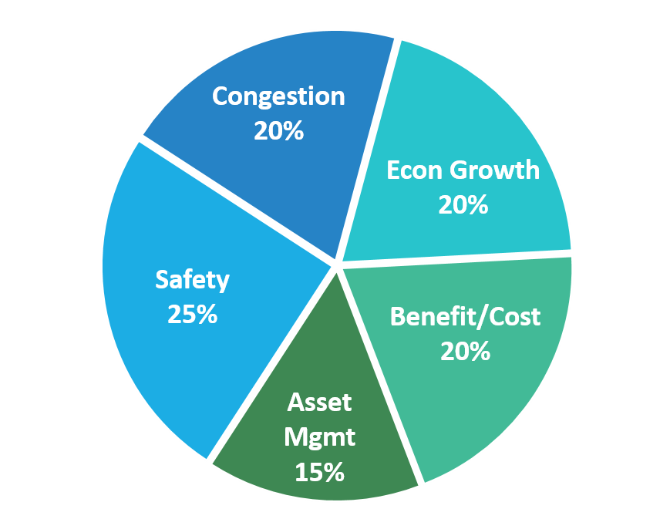
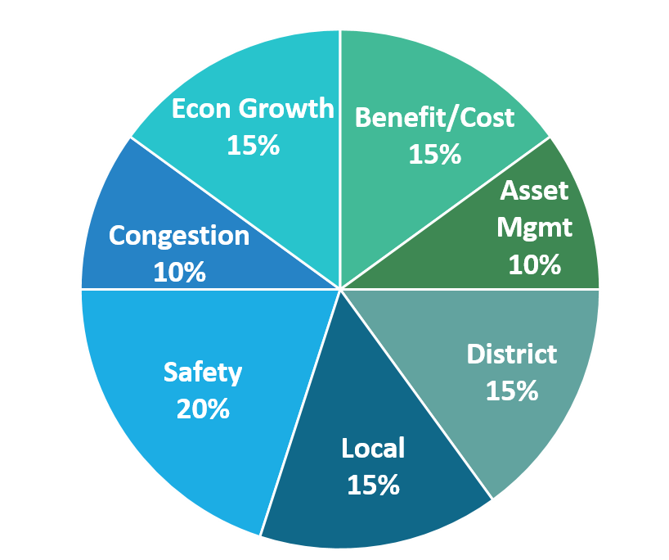
2020 Funding Formula Statewide Regional *
*Standard Regional % listing, Regions may adjust priorities by up or down by 5% with a minimum of 5% in any individual criteria. The overall data portion of the score will remain at 70%. The District and Local Priorities % may not be adjusted.
Notes:
The Statewide score is 100% data
The smaller percentages on the regional side allow for the local boost

Slide 11
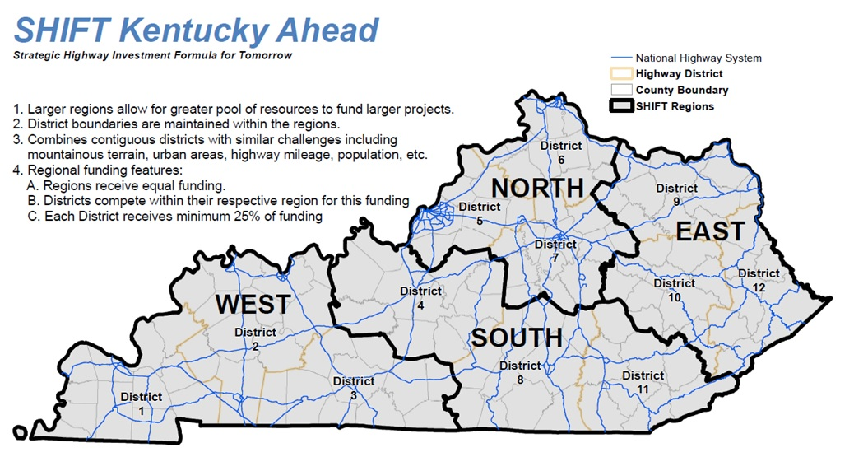
Notes:
On the programming side, for the regional projects, regions were developed to allow for a greater pool of resources to fund large regionally significant projects.
These regions combine contiguous districts with similar challenges.
Each region receives equal funding and each district receives a minimum of 25% of available funding.
Why are Lexington Louisville and NKY together? Inherently these will score better and secure more statewide funding. This ensures a level of geographic distribution.

Slide 12
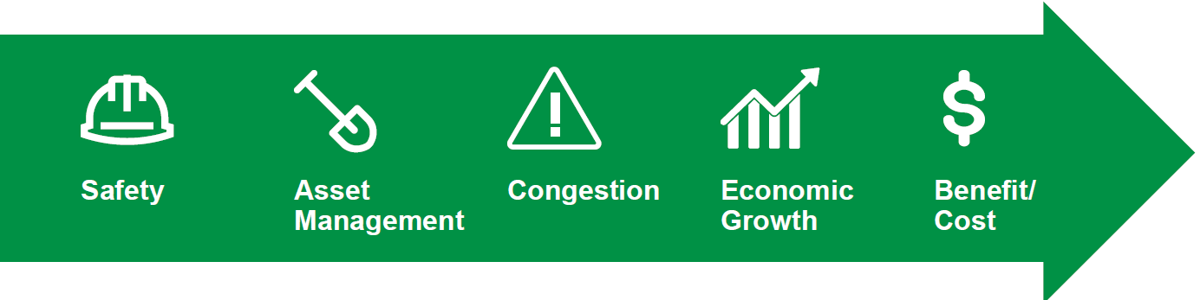
Improving Formula Components
Notes:
We are currently looking at ways to fine tune the SHIFT engine to gear up for SHIFT 2020.

Slide 13
Advisory Committee
Workgroup
KYTC
Area Development Districts
Metropolitan Planning Organizations
KTC (Technical Advisors)
Kentucky House of Representatives
KY Senate
KY League of Cities
KY Association of Counties
KY Judge/Executive Association
Notes:
SHIFT 2018 was the product of a summer workgroup of KYTC staff. In June we started a workgroup for to plan for SHIFT 2020. The next iteration of SHIFT planning also involves groups outside the cabinet in order to improve collaboration, consensus and transparency with key stakeholders.
There are 17 members in the workgroup. They come from several areas of the cabinet State Highway Engineers Office, Program management, Maintenance, Highway Safety Improvement Program, Planning, Highway Design, Districts, MPOs, ADDs. We also have about 40 KYTC staff and KTC staff involved as technical advisors.
The group began meeting in June and will meet through October. We are going through the 2018 SHIFT process and looking for ways to improve the system for 2020.
We also convened an advisory committee in September. That group provided valuable feedback including the important of continuing to educated officials at all levels on the SHIFT process.

Slide 14
Component Improvements
Safety
Incorporating new Highway Safety Manual methods.
Congestion
Updating with field sampled real data as a measure of congestion.
Economic Growth
Improving the travel time modeling inputs for TREDIS economic modeling software.
Adding truck reliability and coal haul routes.
Benefit / Cost
Customizing safety improvement types for KY and improving travel time modeling methods.
Asset Management
Incorporating Pavement Distress Index in Pavement Assessments.
Notes:
The workgroup is analyzed improvements to each of these metrics.
The safety metric allows us to evaluate the project’s crash history and roadway characteristics.
The congestion metric allows us to evaluate any capacity issues.
The economic growth metric allows us to access the project’s economic competitiveness at the state level and accessibility/connectivity at the regional level. As well as measure the impact to our freight network.
The Benefit/Cost metric evaluates the expected benefits in dollars of travel time savings and safety benefits against the project costs.
And, the asset management metric evaluates pavement and bridge issues within the project limits.

Slide 15

Schedule
Phases and Timing | Winter 18-19 | Spring 19 | Early Summer 19 | Late Summer 19 | Fall 19 |  | Winter 19-20 | Spring 20
Sponsorship
Data Verification
Statewide Prioritization
Regional Prioritization
Recommended Highway Plan
Enacted Highway Plan
Notes:
The red highlighted cells indicate when Highway District Offices , Area Development Districts and Metropolitan Planning Organizations will provide direct input during the SHIFT process. The first opportunity is during project sponsorship in the winter. The 2nd opportunity is during Regional Prioritization through project boosts.
Anticipated SHIFT 2020 Schedule :
October 2018 – Workgroup Ends / Refine SHIFT
January - Mid March 2018 : Sponsorship
Mid March – May 2018: Data Verification
Early June 2018 : Statewide Prioritization
Mid June – August 2018: Regional Prioritization
August – December 2018: State Highway Plan Development
January 2019: Recommended Highway Plan
April 2019: Enacted Highway Plan

